Slide 1
DESIGN AND IMPLEMENTATION OF KALMAN FILTER-BASED MPC-MPPT ALGORITHM FOR PV DC-DC CONVERTER SYSTEMS
Master of Science in Electrical Engineering
Matthew Capuano
Advisor: Dr. Xinwei Niu
Committee members: Dr. Javad Khazaei
Dr. Kiana Karami
Dr. Nashwa Elaraby
1

Slide 2
Outline of Presentation
Introduction
Background and Literature Review
Significance
Experimental Design
Results and Discussion
Conclusion
2

Slide 3
Energy Resources
Increased population and energy-consumption
Primary resources (oil, gas, coal) have a harmful impact on the environment
Renewable energy such as wind, solar, etc. are effective alternatives
Solar energy via photovoltaic (PV) cells are second most deployed renewable technology[1]
PV is largest renewable power source based on new installations per year[1]
[1] A. Harrag, S. Messalti and Y. Daili, "Innovative Single Sensor Neural Network PV MPPT," 2019 6th International Conference on Control, Decision and Information Technologies (CoDIT), Paris, France, 2019, pp. 1895-1899, doi: 10.1109/CoDIT.2019.8820335.
3

Slide 4
Solar Energy
Pros:
Readily available resource
Minimal maintenance cost
Decreasing implementation cost
Cons:
High initial capital investments for PV panels
‘Grid-Parity’ issue: high cost per unit PV energy extraction
4

Slide 5
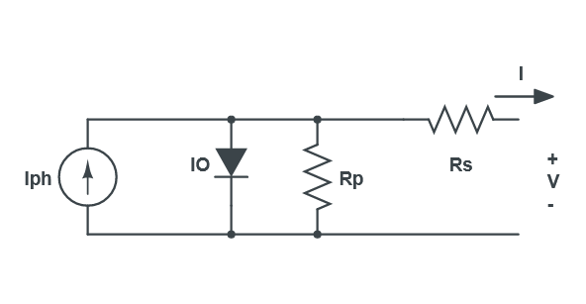
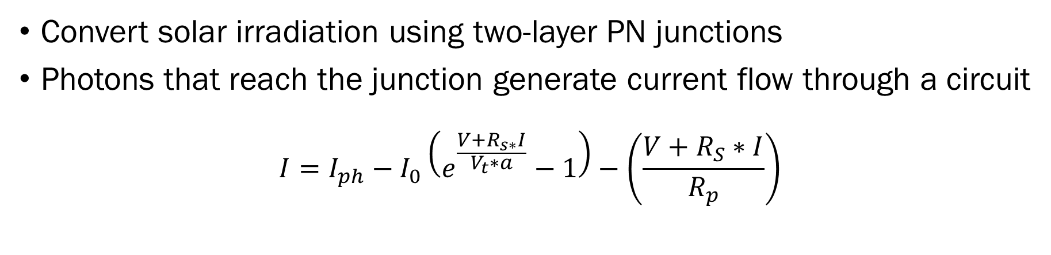
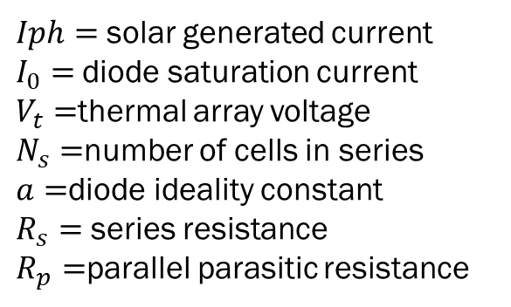
Photovoltaics
Convert solar irradiation using two-layer PN junctions
Photons that reach the junction generate current flow through a circuit
$$I=I_{ph}−I_{0}\left(e^{\frac{V+R_{s∗}I}{V_{t}∗a}}−1\right)−\left(\frac{V+R_{S}∗I}{R_{p}}\right)$$
$Iph=$solar generated current
$I_{0}=$diode saturation current
$V_{t}=$thermal array voltage
$N_{s}=$number of cells in series
$a=$diode ideality constant
$R_{s}=$ series resistance
$R_{p}=$parallel parasitic resistance
Equivalent circuit model of a Photovoltaic
5

Slide 6
Improve PV System Efficiency
Operate the PV system at its maximum power point(MPP)
Problem – The PV MPP is time-variable, and depends on multiple factors including environmental temperature, solar irradiance, shadowing effects, surface cleanliness, array/cell arrangement, etc.
Current needed for MPP
Voltage needed for MPP
Maximum Power Point given specific Temperature and Irradiance values
Maximum Power Point for Photovoltaics
6

Slide 7
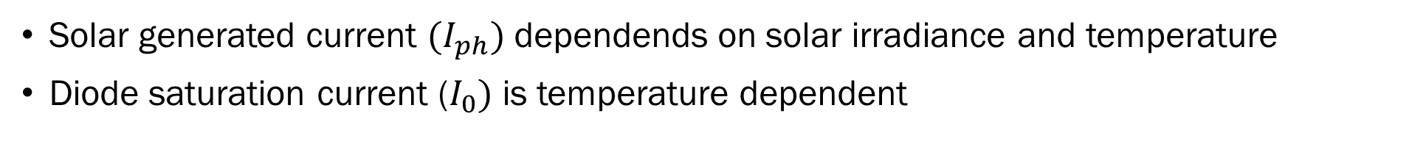
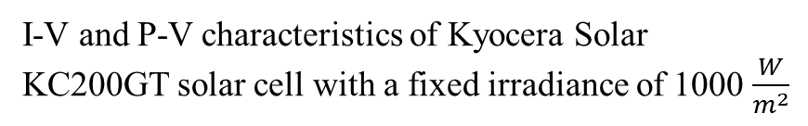
Photovoltaic MPP
Solar generated current ${(I}_{ph})$ dependends on solar irradiance and temperature
Diode saturation current ($I_{0})$ is temperature dependent
Variable Solar irradiance
Variable Temperature
I-V and P-V characteristics of Kyocera Solar KC200GT solar cell with a fixed irradiance of 1000 $\frac{W}{m^{2}}$
I-V and P-V characteristics of Kyocera Solar KC200GT solar cell with a fixed temperature of 25 deg. C
7

Slide 8
How to Track MPP
Current solution:
Create Maximum Power Point Tracking (MPPT) Algorithm to control the DC- DC converter, which is connected to the PV, to guarantee the maximum power extraction
MPPT
Algorithm/Controller
PV
DC-DC converter
Different DC applications
8

Slide 9
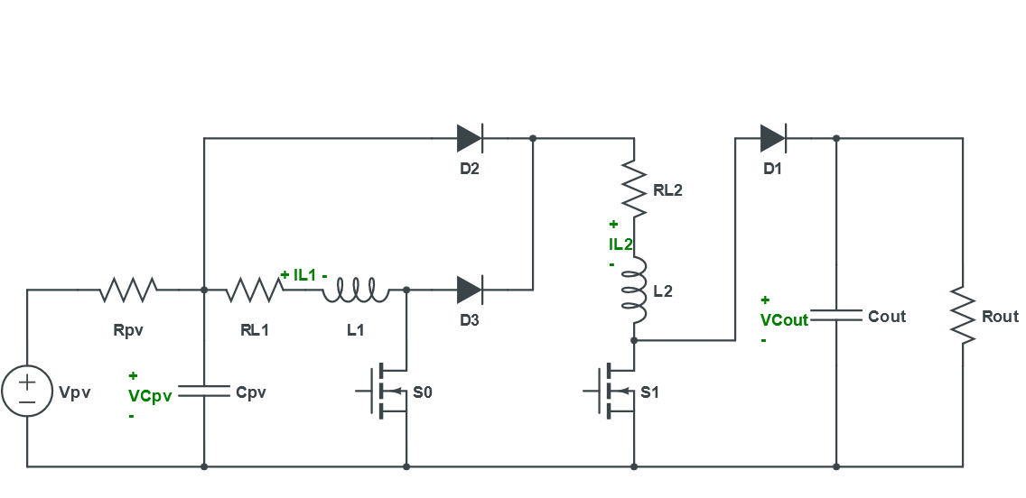
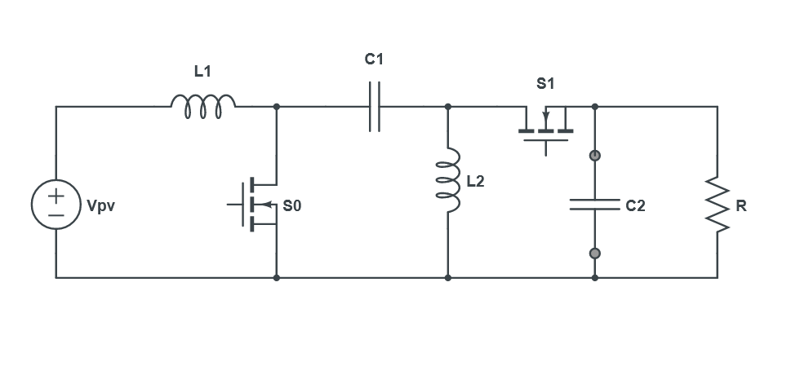
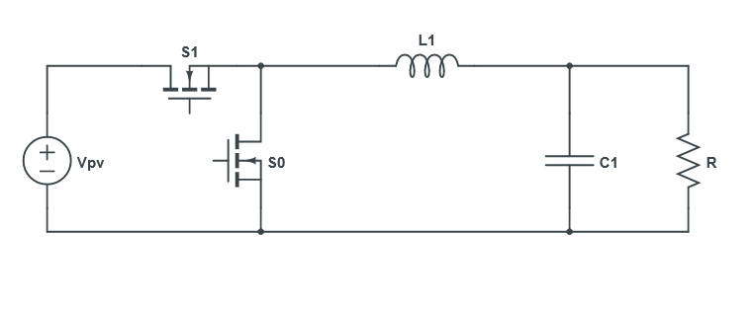
DC-DC Converter Topologies
Custom designed to achieve high gain, low switch voltage stress, and a reduced need for high duty cycles
Either non-isolated(general applications) or isolated(high voltage applications)
Synchronous Buck Converter
Bidirectional SEPIC Converter
Custom Topology High Gain Boost Converter
9

Slide 10
Outline of Presentation
Introduction
Background and Literature Review
Significance
Experimental Design
Results and Discussion
Conclusion
10

Slide 11
MPPT Algorithms Design
MPPT algorithm:
High efficiency energy transfer
Steady output voltage with minimal oscillations
Fast and accurate transients
Overall effectiveness determined by:
Power efficiency
Cost
Hardware complexity
Number of sensors
Steady state tracking efficiency
Algorithm Complexity
Transient Response
Degree of steady state oscillations
11

Slide 12
MPPT Algorithms
Direct – applies controls to converter and observes how MPP is affected
Perturb and Observe, Incremental Conductance
Indirect – analyzes short circuit current and open circuit voltage of PV cell
Fractional Open Circuit, Fractional Short Circuit
Soft computing – computational/data analytics method to determine MPP
Neural Networks, Particle Swarm Optimization
12

Slide 13
Problems with Existing Research
In general:
Many designs have extreme tradeoffs (e.g. complexity vs performance)
The overall system cost and noise may be increased
Noise-related:
Many algorithms didn’t perform well when noise is introduced
Most research ends at simulation and ignore real world noise effects
Very little noise-related research with MPPT algorithms
13

Slide 14
Existing MPPT Algorithms Comparison
Many algorithms have tradeoffs
Table 1: Excerpt from ‘The Review of Most Common MPPT Algorithms’ by authors of [2]
MPPT Algorithm | Category | Oscillations | Efficiency | Tracking Speed | Complexity | Cost
Fractional Short Circuit | Indirect | Sometimes | Low | Fast | Simple | Cheap
Fractional Open Circuit | Indirect | Sometimes | Low | Fast | Simple | Cheap
Perturb & Observe | Direct | Yes | Medium | Slow | Simple | Medium
Incremental Conductance | Direct | Sometimes | Good | Medium | Medium | Medium
Fuzzy Logic | Soft | No | Very Good | Fast | Complex | Very Expensive
Neural Network | Soft | No | Very Good | Fast | Complex | Very Expensive
Particle Swarm Optimization | Soft | Sometimes | Good | Fast | Complex | Very Expensive
[2] S. Motahhir, A. El Hammoumi, and A. El Ghzizal, “The most used MPPT algorithms: Review and the suitable low-cost embedded board for each algorithm,” Journal of Cleaner Production, vol. 246, p. 118983, 2020.
14

Slide 15
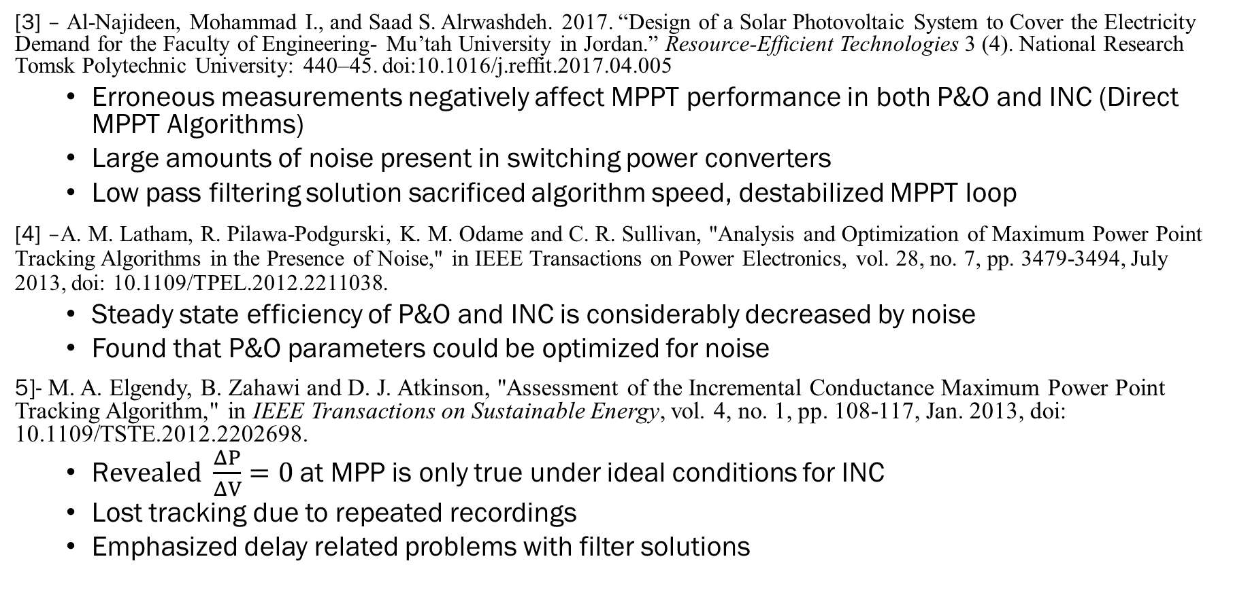
Literature Review
[3] – Al-Najideen, Mohammad I., and Saad S. Alrwashdeh. 2017. “Design of a Solar Photovoltaic System to Cover the Electricity Demand for the Faculty of Engineering- Mu’tah University in Jordan.” Resource-Efficient Technologies 3 (4). National Research Tomsk Polytechnic University: 440–45. doi:10.1016/j.reffit.2017.04.005
Erroneous measurements negatively affect MPPT performance in both P&O and INC (Direct MPPT Algorithms)
Large amounts of noise present in switching power converters
Low pass filtering solution sacrificed algorithm speed, destabilized MPPT loop
[4] –A. M. Latham, R. Pilawa-Podgurski, K. M. Odame and C. R. Sullivan, "Analysis and Optimization of Maximum Power Point Tracking Algorithms in the Presence of Noise," in IEEE Transactions on Power Electronics, vol. 28, no. 7, pp. 3479-3494, July 2013, doi: 10.1109/TPEL.2012.2211038.
Steady state efficiency of P&O and INC is considerably decreased by noise
Found that P&O parameters could be optimized for noise
5]- M. A. Elgendy, B. Zahawi and D. J. Atkinson, "Assessment of the Incremental Conductance Maximum Power Point Tracking Algorithm," in IEEE Transactions on Sustainable Energy, vol. 4, no. 1, pp. 108-117, Jan. 2013, doi: 10.1109/TSTE.2012.2202698.
R$evealed \frac{ΔP}{ΔV}=0$at MPP is only true under ideal conditions for INC
Lost tracking due to repeated recordings
Emphasized delay related problems with filter solutions
15

Slide 16
Literature Review(cont’d)
[6]- O. Abdel-Rahim and H. Wang, "A new high gain DC-DC converter with model-predictive-control based MPPT technique for photovoltaic systems," in CPSS Transactions on Power Electronics and Applications, vol. 5, no. 2, pp. 191-200, June 2020, doi: 10.24295/CPSSTPEA.2020.00016.
Significant increase to system complexity and resources
No information on how it responds to noise, used current sensing
Reducing sensor count solution may not hold under the noise(uses ideal equations)
[7]- Calavia, M., J. M. Perié, J. F. Sanz, and J. Sallán. "Comparison of MPPT strategies for solar modules." In Proc. Int. Conf. Renewable Energies Power Quality, pp. 22-25. 2010.
Considerable ripple and oscillations occur in the INC algorithm due to noise
Even low levels of noise can cause significant effects algorithm performance
[8]- M.A. Elgengy, D.J. Atkinson, B. Zahawi, “Experimental Investigation of the Incremental Conductance Maximum Power Point Tracking Algorithm at High Perturbation Rates”, Institute of Engineering and Technology Renewable Power Generation, Volume 10, Issue 2, February 2016, p. 133 – 139
Concluded that certain parameters in INC can reduced error from noise at the cost of oscillations, lower stability, lower efficiency
16

Slide 17
Outline of Presentation
Introduction
Background and Literature Review
Significance
Experimental Design
Results and Discussion
Conclusion
17

Slide 18
Significance
Strong tracking algorithm to maximize the system performance
Robust performance even in the presence of real-life noise
Reduced sensor count to improve the system efficiency
Reduced overall system cost to improve practicality
Implement and verify the design on FPGA platform for real-time analysis
18

Slide 19
Outline of Presentation
Introduction
Background and Literature Review
Significance
Experimental Design
Results and Discussion
Conclusion
19

Slide 20
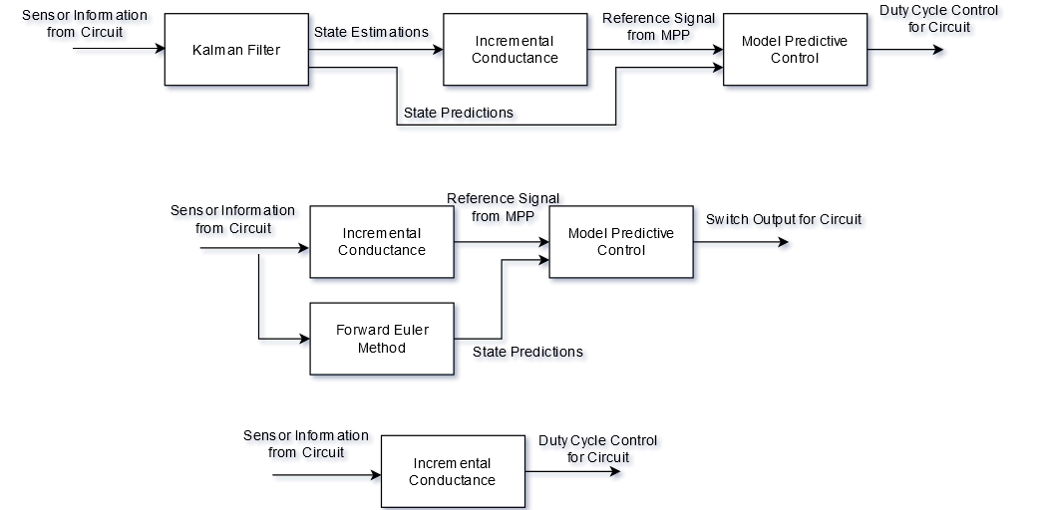
Proposed solution - Kalman Filter-based MPC-MPPT Algorithm
Estimate the state of DC-DC converter – reduces sensor count, filters noise
Predict future states of system, feed to the Incremental Conductance algorithm
Find maximum power point from state information, create a reference current
Choose the predicted state closest to the reference signal and apply duty cycle control
Build a Model-Predictive Control module for final decision
Kalman Filter MPC-INC Algorithm Block Diagram
20

Slide 21
Methods
Compared to MPC-INC(model-predictive control – incremental conductance) and INC(incremental conductance) algorithms in MATLAB
Implemented on FPGA for real world hardware testing
KF-MPC-INC algorithm (top), MPC-INC algorithm (middle), INC algorithm (bottom)
21

Slide 22
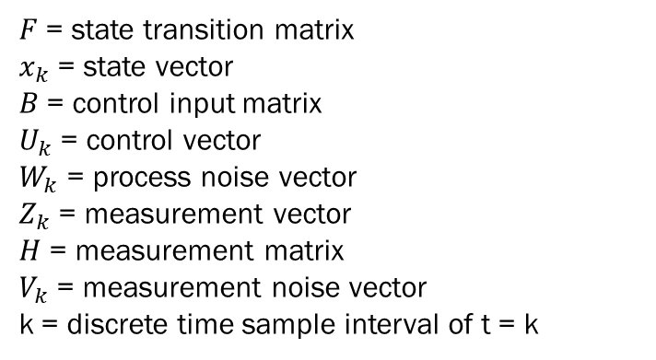
Kalman Filter Design
State estimator/predictor of linear dynamic systems presented in the state space format
Uses F, B, H (discrete equivalent of A, B, C) state space matrices being estimated with real time values of input (u) and output (z) to estimate states (x)
Utilizes Bayesian filter theory to remove noise present in both states and outputs
$$x_{k}=Fx_{k−1}+Bu_{k−1}+w_{k−1}$$
$$z_{k}=Hx_{k}+v_{k}$$
$F$= state transition matrix
$x_{k}$= state vector
$B$= control input matrix
$U_{k}$= control vector
$W_{k}$= process noise vector
$Z_{k}$= measurement vector
$H$ = measurement matrix
$V_{k}$= measurement noise vector
k = discrete time sample interval of t = k
22

Slide 23
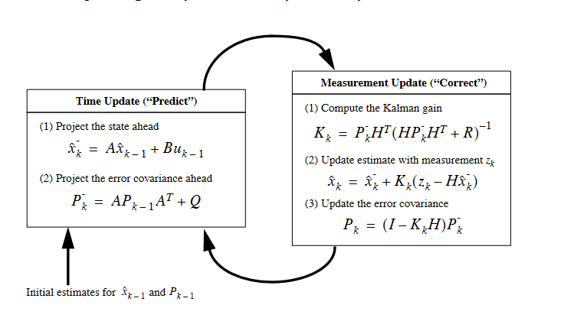
The Kalman Filter Parameter Updates
Recursive algorithm format of predict and update using U and Z
Bishop, Gary, and Greg Welch. "An introduction to the kalman filter." Proc of SIGGRAPH, Course 8, no. 27599-23175 (2001): 41.
23

Slide 24
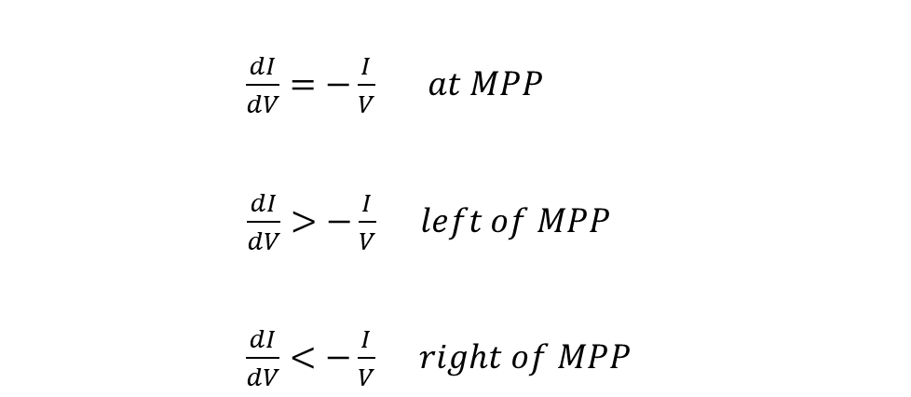
Incremental Conductance (INC)
Higher level of computational complexity compared to P&O
Higher sampling rates, digital implementation, high levels of speed control
Reduces output oscillation by reaching steady state
Tracks faster with higher degree of accuracy
$\frac{dI}{dV}=−\frac{I}{V} at MPP$
$\frac{dI}{dV}>−\frac{I}{V} left of MPP$
$\frac{dI}{dV}<−\frac{I}{V} right of MPP$
24

Slide 25
Model Predictive Control (MPC) Scheme
Predicts future behavior of desired control variables through predictions over a time horizon of t = (k +1), (k+2), …(k+N)
Applies variety of inputs to state space model on every timestep and compares output to a cost function at time t = (k+N)
Output that minimizes cost function at end of time horizon is chosen, but control is only applied to time t = k+1
Process repeats on every timestep
25

Slide 26
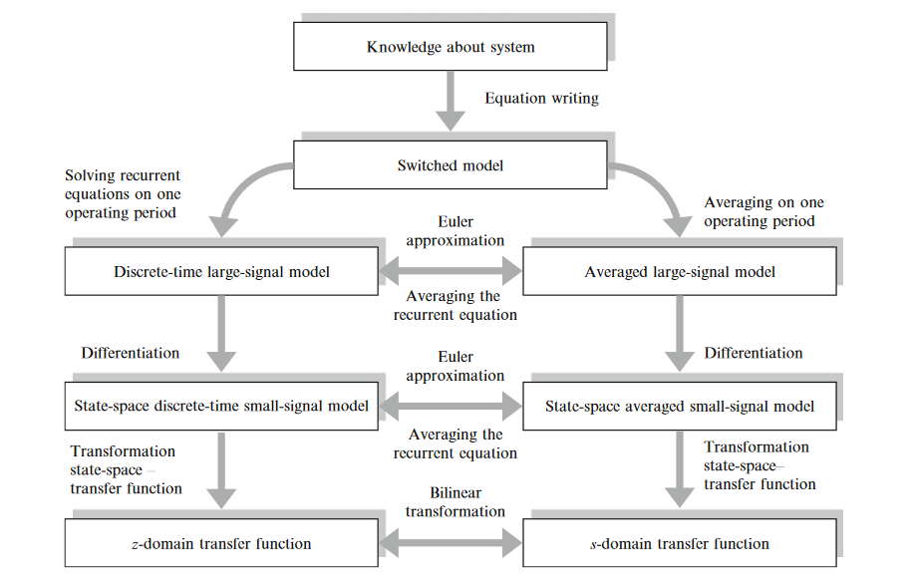
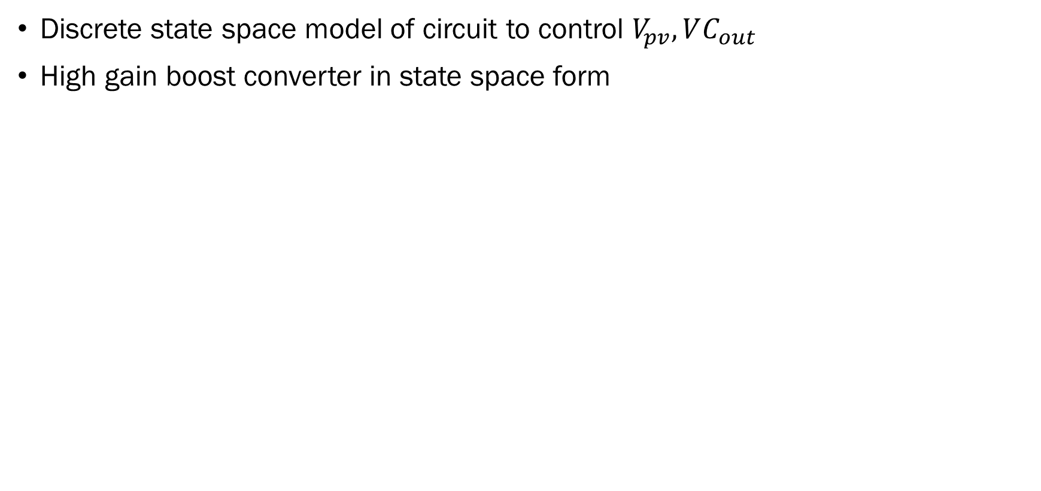
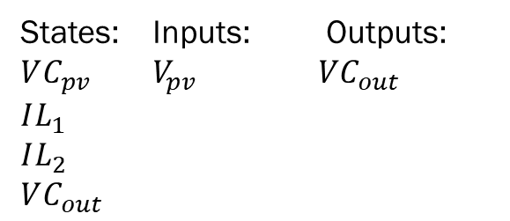
Circuit Modeling/Boost converter
Discrete state space model of circuit to control $V_{pv}, VC_{out}$
High gain boost converter in state space form
States: Inputs: Outputs:
$VC_{pv}$ $V_{pv}$ $VC_{out}$
$$IL_{1}$$
$$IL_{2}$$
$$VC_{out}$$
High gain boost converter topology used for this experiment
Relationship Between Mathematical Circuit Models in Terms of Derivation
Bacha, S., Munteanu, I. and Bratcu, A.I., 2014. Power electronic converters modeling and control. Advanced textbooks in control and signal processing, 454, p.454.
26

Slide 27
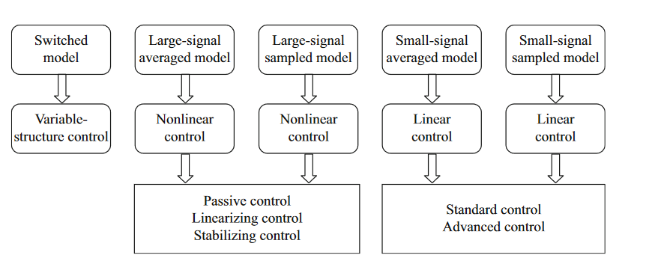
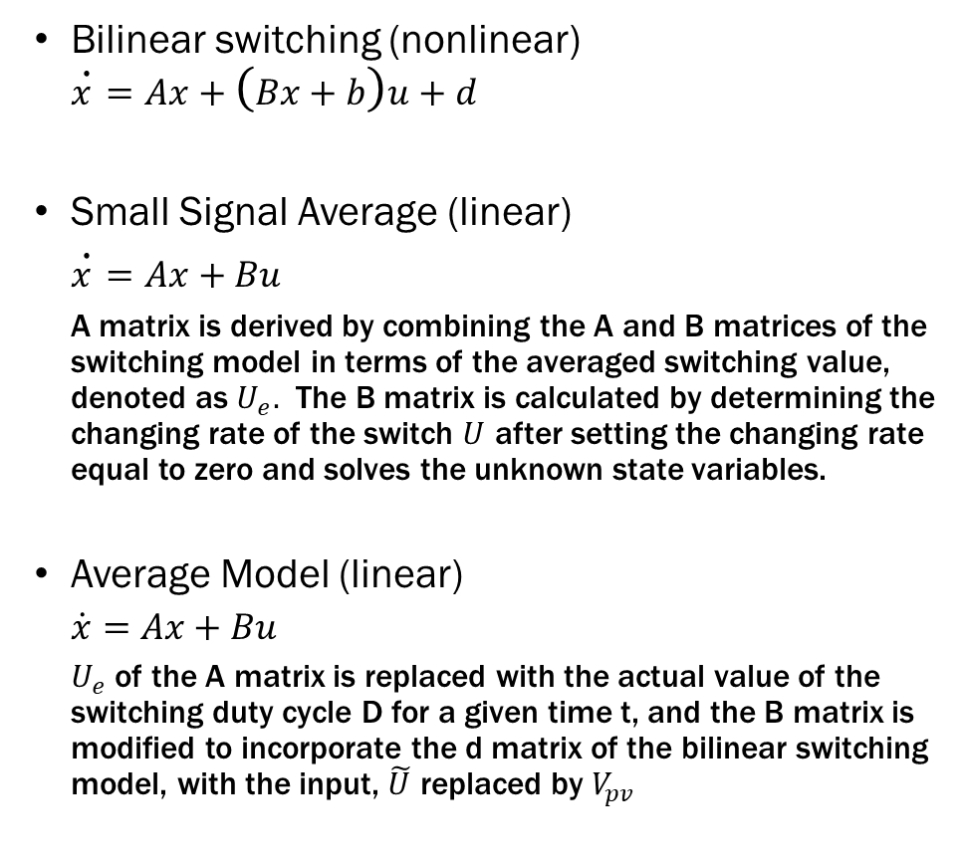
Derived Mathematical Circuit Models
Bilinear switching (nonlinear)
$$\dot{x}=Ax+\left(Bx+b\right)u+d$$
Small Signal Average (linear)
$\dot{x}=Ax+Bu$
A matrix is derived by combining the A and B matrices of the switching model in terms of the averaged switching value, denoted as $U_{e}.$ The B matrix is calculated by determining the changing rate of the switch $U$ after setting the changing rate equal to zero and solves the unknown state variables.
Average Model (linear)
$\dot{x}=Ax+Bu$
$U_{e}$ of the A matrix is replaced with the actual value of the switching duty cycle D for a given time t, and the B matrix is modified to incorporate the d matrix of the bilinear switching model, with the input, $\tilde{U}$ replaced by $V_{pv}$
Relationship Between Circuit Models and Possible Control Laws
27

Slide 28
State Space Model Accuracy Validation
Comparison of $VC_{pv}$responses across the circuit model and mathematical models
Comparison of $IL_{1}, IL_{2}$ responses across the circuit model and mathematical models
28
Comparison of $VC_{out}$responses across the circuit model and mathematical models

Slide 29
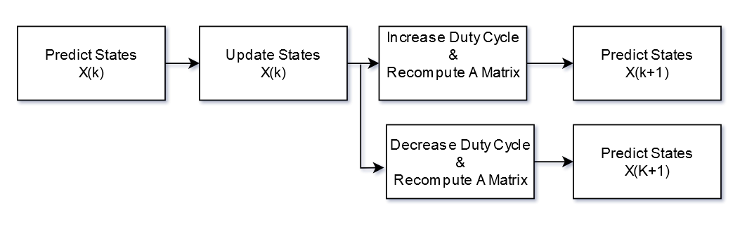
Kalman Filter Algorithm
State space model discretization method: Forward Euler
$$x\left[k+1\right]≅\left(I+A∗T_{s}\right)x\left[k\right]+\left(T_{s}∗B\right)u\left[k\right]$$
Block Diagram of Kalman Filter Algorithm
A matrix contains existing duty cycling information
After prediction is made for x(k), A matrix is recomputed with increased and decreased values, and the updated values of X(k) are fed back into Kalman filter algorithm
29

Slide 30
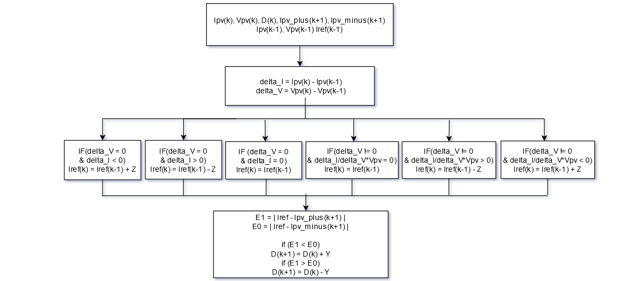

MPC-INC Algorithm Design
Existing and Future state estimates from KF is passed to MPC-INC algorithm
$$I_{pv}=\frac{V_{pv}−VC_{pv}}{R_{pv}}$$
30
MPC-INC Algorithm

Slide 31
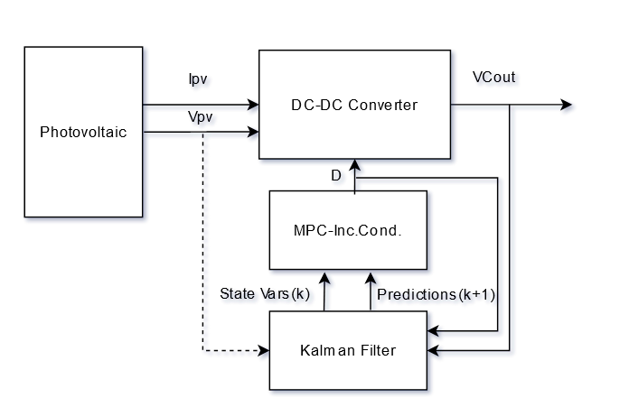
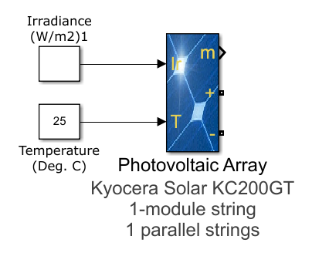
MATLAB Simulink Setup
Block diagram of the KF-MPC-INC design
Kyocera Solar KC200GT Photovoltaic Array
31

Slide 32
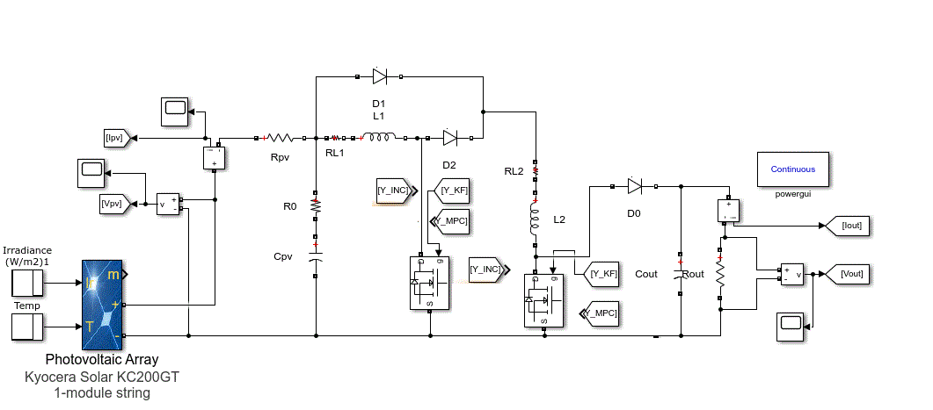
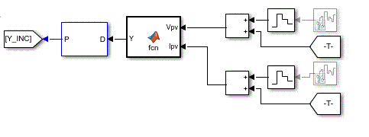
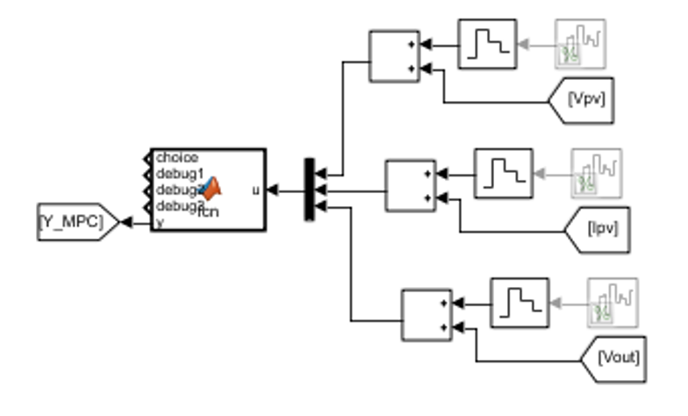
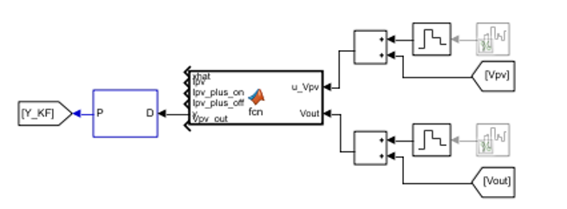
MATLAB Simulink Setup(cont’d)
MATLAB Simulation setup of circuit
PV Input Parameters and Expected Power at MPP
Simulation Time (seconds) | PV Input Irradiance (W/m²) | PV Input Temperature (deg. C) | Power at MPP (W)
0 | 800 | 25 | 161.5
.5 | 1000 | 25 | 200.2
1 | 800 | 25 | 161.5
1.25 | 1000 | 25 | 200.2
1.5 | 1000 | 45 | 182.8
2 | 1000 | 25 | 200.2
INC Algorithm block
MPC-INC Algorithm block
KF-MPC-INC Algorithm block
32

Slide 33
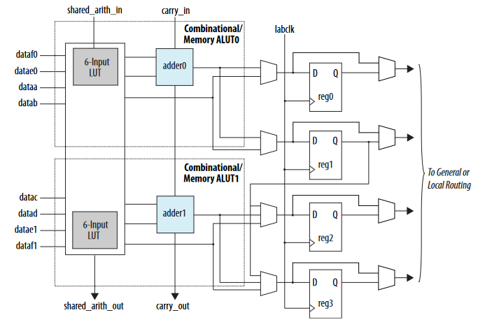
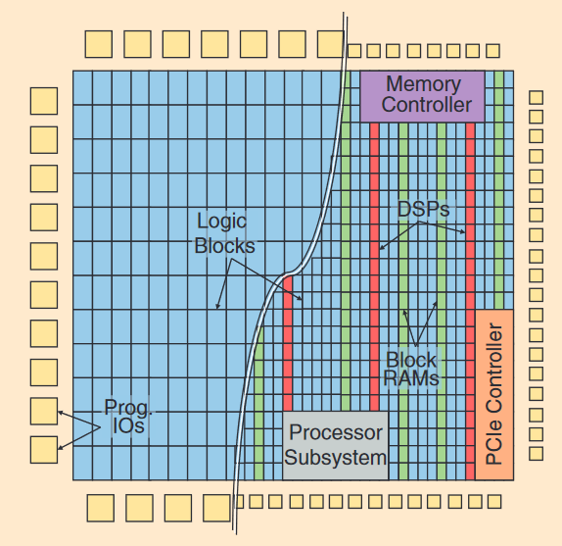
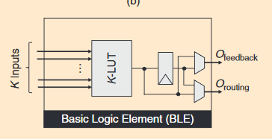
FPGAs
Field Programmable Gate Array – can be reconfigured to emulate the digital circuit system
Fast and efficient design cycles
Hardware Description Language(HDL)
Standard structure of a logic element (left), standard structure of an adaptive logic element (middle), comparison of traditional FPGA architecture versus modern FPGA architecture (right)
Boutros and V. Betz, "FPGA Architecture: Principles and Progression," in IEEE Circuits and Systems Magazine, vol. 21, no. 2, pp. 4-29, Secondquarter 2021, doi: 10.1109/MCAS.2021.3071607.
Intel Corporation. Intel Cyclone V Device Handbook (CV-5V2). 2021.
33

Slide 34
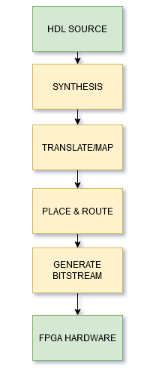
FPGAs(cont’d)
High-efficient system design through custom designed, instruction free hardware architecture, or softcore processor architectures.
Widely used in machine learning, signal processing, finance, embedded systems, computer networking, aerospace, etc.
Pros:
Faster design times compared to ASICs
Reprogrammable
Logic level implementation (parallelism and pipelining)
Typically contain large amount of IO
Cons:
Longer design times compared to software
Costly/hard to scale compared to ASIC
Less translation/mapping capability compared to ASIC
Lower clock speeds compared to ASIC
FPGA Design Flow
From HDL to Hardware
34

Slide 35
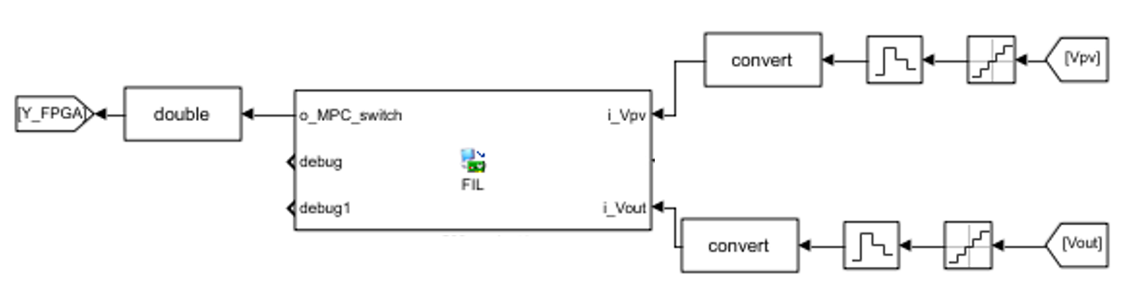
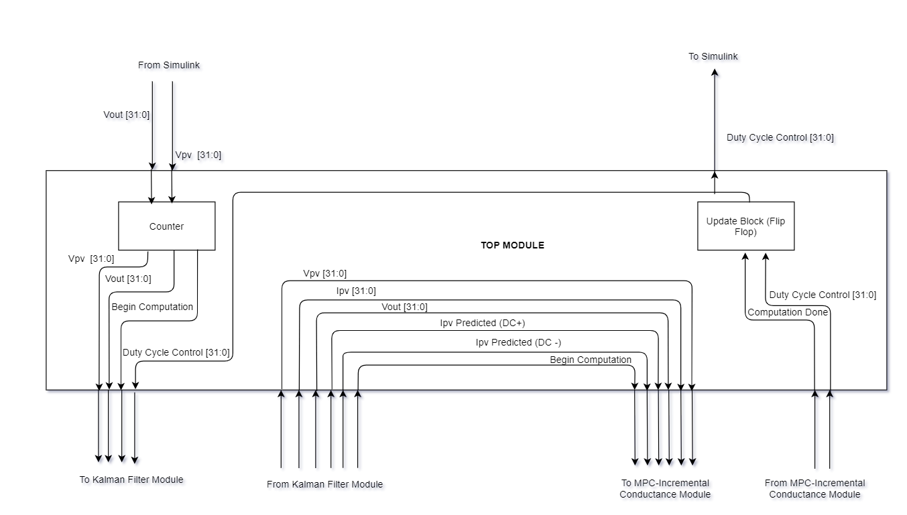
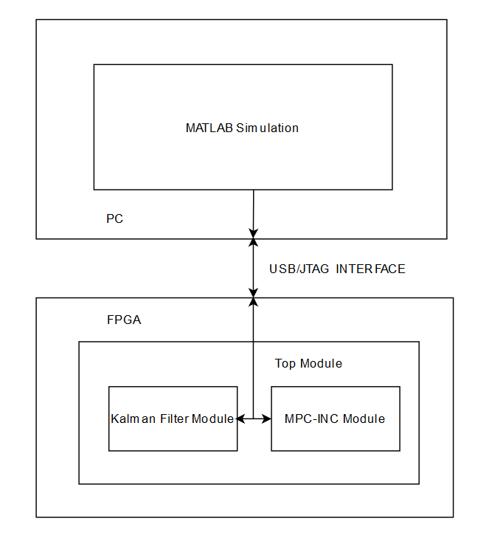
FPGA HIL Setup
FPGA HIL Block in MATLAB Simulation
MATLAB Simulation – FPGA interconnect
FPGA Top Module Block Diagram
35

Slide 36
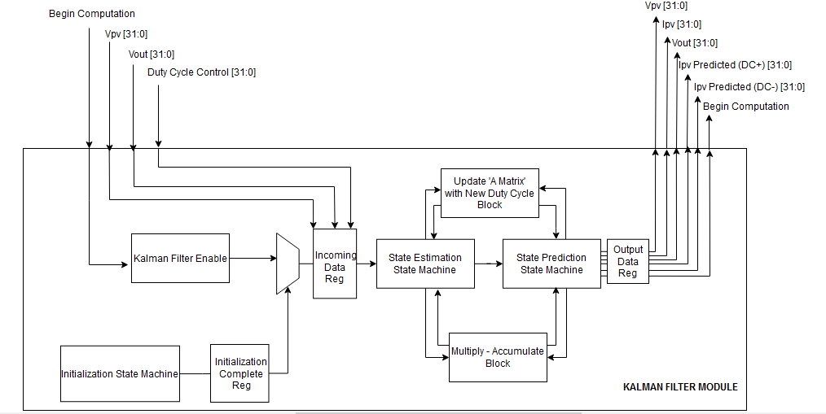
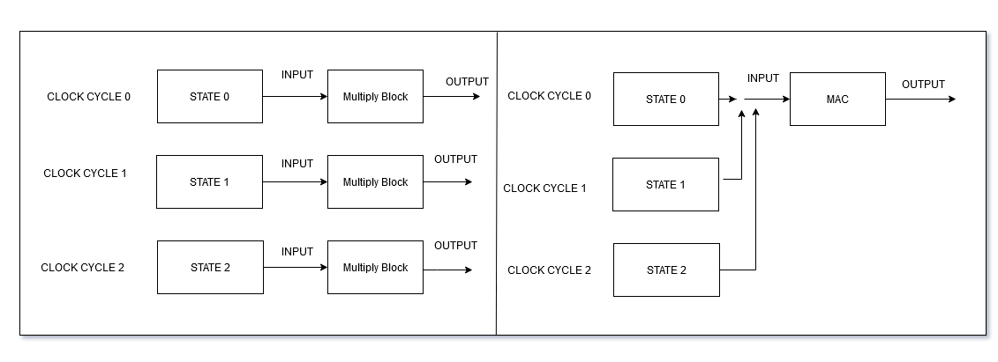
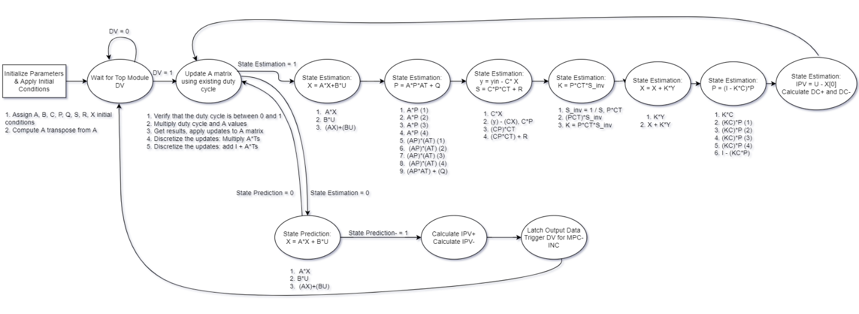
Kalman Filter Module
Multiply – Accumulate Block (MAC)
Kalman Filter Block Diagram
Kalman Filter State Machine
36

Slide 37
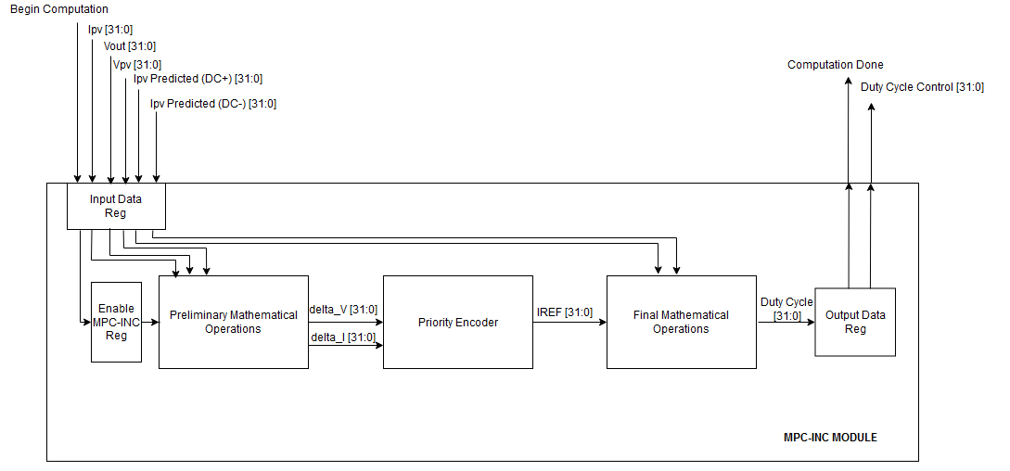
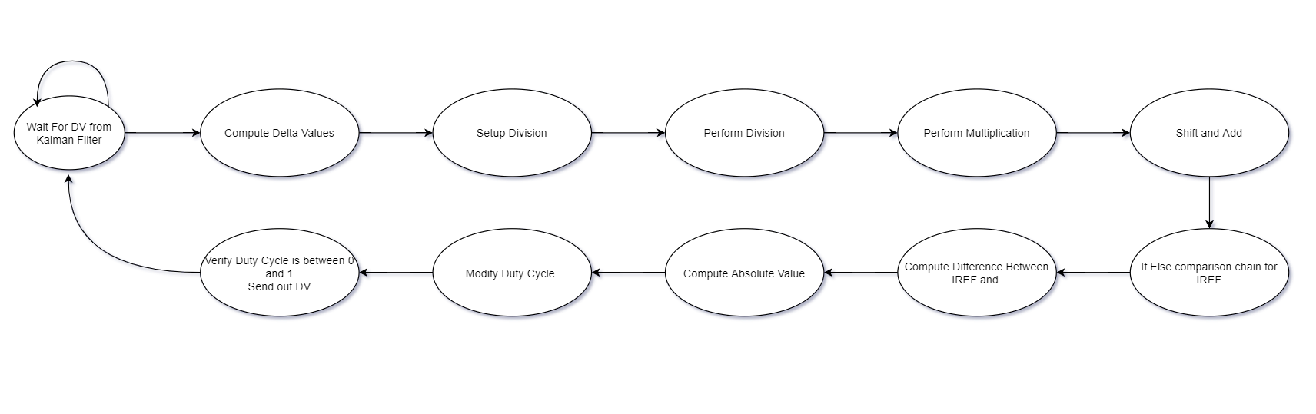
MPC-INC Module
MPC-INC Block Diagram
MPC-INC State Machine
37

Slide 38
Outline of Presentation
Introduction
Background and Literature Review
Significance
Experimental Design
Results and Discussion
Conclusion
38

Slide 39
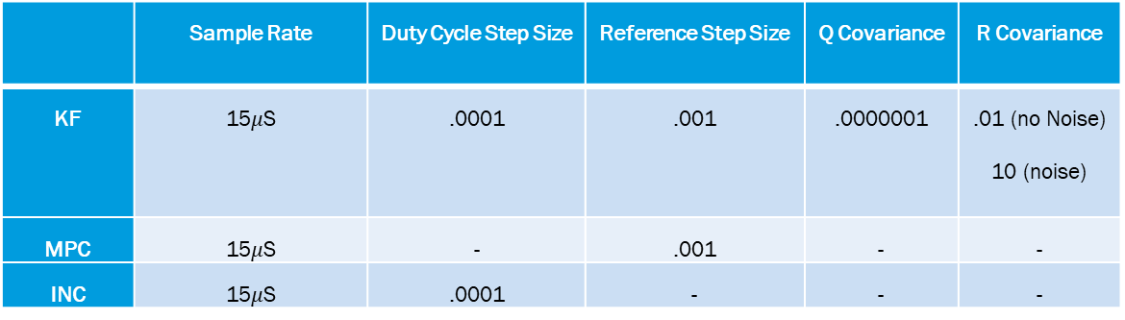
Software Simulation
KF, INC, MPC-INC algorithms were tested with and without noise
Noise was incremented until at least one algorithm lost tracking
Steady state oscillation/response time to changes in irradiance/response time to changes in temperature/overall power efficiency were analyzed
Values were evaluated at both PV and load output locations
Multiple simulations, with various modified algorithm parameters were evaluated (sample rates, duty cycle step, reference step)
Baseline Parameter Setup
 | Sample Rate | Duty Cycle Step Size | Reference Step Size | Q Covariance | R Covariance
KF | 15$μ$S | .0001 | .001 | .0000001 | .01 (no Noise) 10 (noise)
MPC | 15$μ$S | - | .001 | - | -
INC | 15$μ$S | .0001 | - | - | -
39

Slide 40
PV Power and the Output Power – No Noise
Power Efficiency at Steady State
Steady State Oscillations
Transient Response to Irradiance Change
Transient Response to Temp. Change
40

Slide 41

Overall Power Analysis
Noise Power of $1∗{10}^{−10}$
Overall PV Power Response
Overall PV Power Efficiency
41

Slide 42
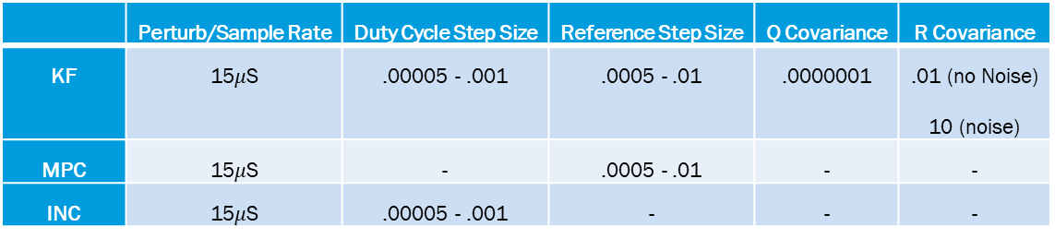
PV/Output Power with Modified Parameter – No Noise
Steady State Oscillations with Decreased(left) and Increased(right) Step Parameter
Transient Response to Irradiance Change with Decreased(left) and Increased(right) Step Parameter
Modified Step Parameters used for Modified Step Simulations
 | Perturb/Sample Rate | Duty Cycle Step Size | Reference Step Size | Q Covariance | R Covariance
KF | 15$μ$S | .00005 - .001 | .0005 - .01 | .0000001 | .01 (no Noise) 10 (noise)
MPC | 15$μ$S | - | .0005 - .01 | - | -
INC | 15$μ$S | .00005 - .001 | - | - | -
42

Slide 43
PV/Output Power with Modified Parameters – No Noise(cont’d)
Transient Response to Rapid Temp. Change with Decreased(left) and Increased(right) Step Parameter
PV Power Efficiency at Steady State Decreased(left) and Increased(right) Step Parameter
43

Slide 44
Overall Power Analysis with Decreased/Increased Step Parameter
Noise Power of $1∗{10}^{−10}$
Overall PV Power Response with Decreased(left) and Increased(right) Step Parameter
Overall PV Power Efficiency with Decreased(left) and Increased(right) Step Parameter
44

Slide 45
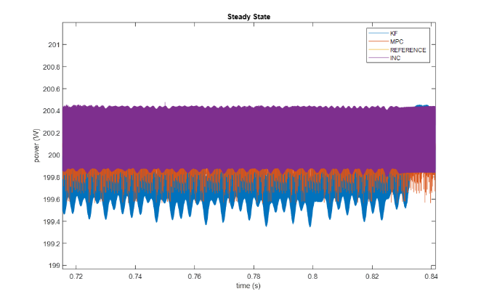
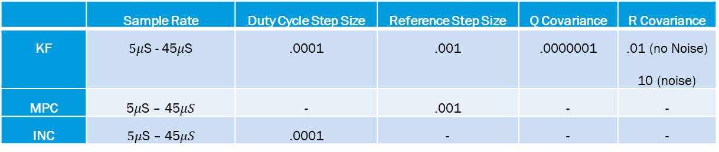
PV/Output Power with Modified Sampling Parameters – No Noise
Steady State Oscillations with Decreased(left)/Increased(right) Sampling Parameter
Transient Response to Irradiance Change with Decreased(left)/Increased(right) Sampling Parameter
Modified Sampling Parameters used for Modified Sampling Simulations
 | Sample Rate | Duty Cycle Step Size | Reference Step Size | Q Covariance | R Covariance
KF | $5μ$S - 45$μ$S | .0001 | .001 | .0000001 | .01 (no Noise) 10 (noise)
MPC | 5$μ$S – 45$μS$ | - | .001 | - | -
INC | $5μ$S – 45$μS$ | .0001 | - | - | -
45

Slide 46
PV/Output Power with Modified Sampling Parameters – No Noise
Transient Response to Temperature Change with Decreased(left)/Increased(right) Sampling Parameter
Power Efficiency at Steady State with Decreased(left)/Increased(right) Sampling Parameter
46

Slide 47
Overall Power Analysis with Modified Sampling Parameters
Noise Power of $1∗{10}^{−10}$
Overall PV Power Response with Decreased(left)/Increased(right) Sampling Parameter
Overall PV Power Efficiency with Decreased(left)/Increased(right) Sampling Parameter
47

Slide 48
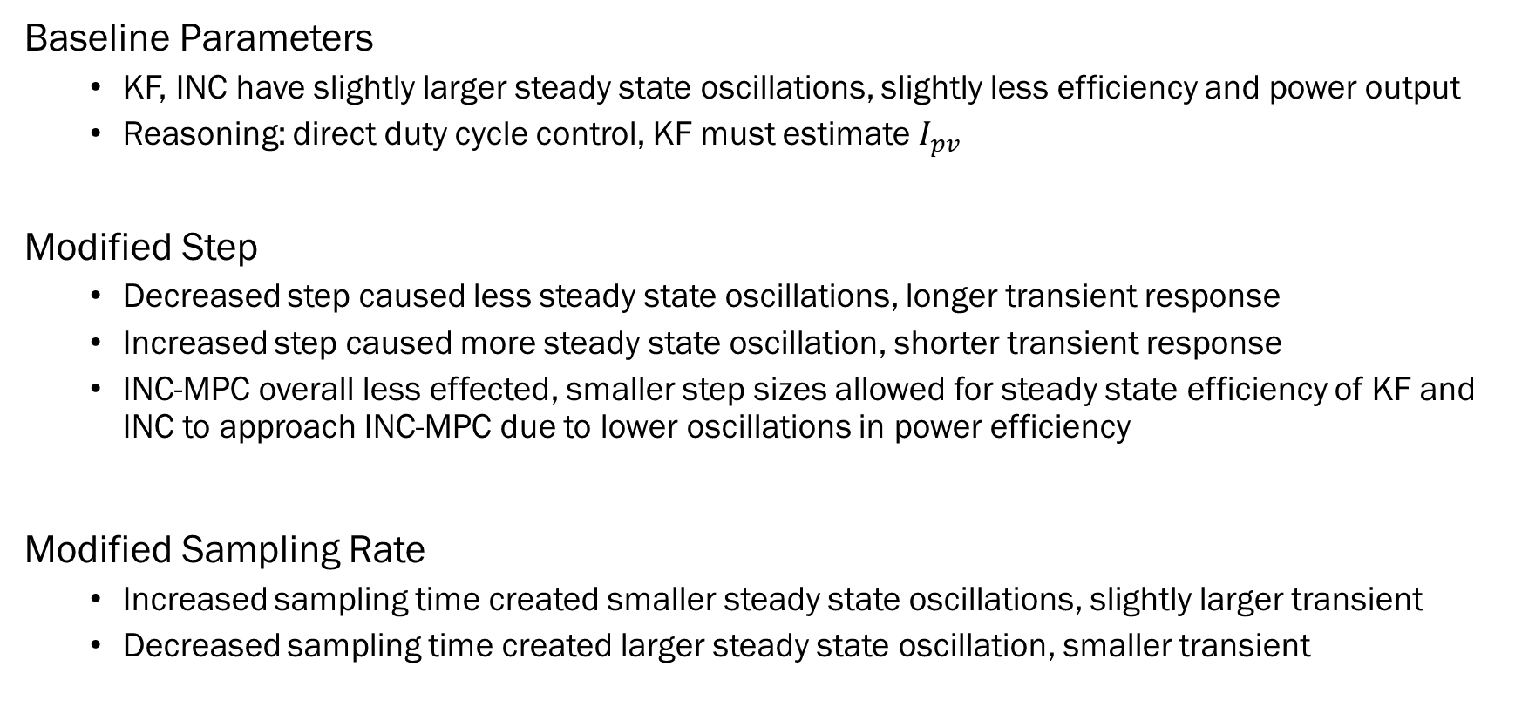
Discussion – without Noise
Baseline Parameters
KF, INC have slightly larger steady state oscillations, slightly less efficiency and power output
Reasoning: direct duty cycle control, KF must estimate $I_{pv}$
Modified Step
Decreased step caused less steady state oscillations, longer transient response
Increased step caused more steady state oscillation, shorter transient response
INC-MPC overall less effected, smaller step sizes allowed for steady state efficiency of KF and INC to approach INC-MPC due to lower oscillations in power efficiency
Modified Sampling Rate
Increased sampling time created smaller steady state oscillations, slightly larger transient
Decreased sampling time created larger steady state oscillation, smaller transient
48

Slide 49
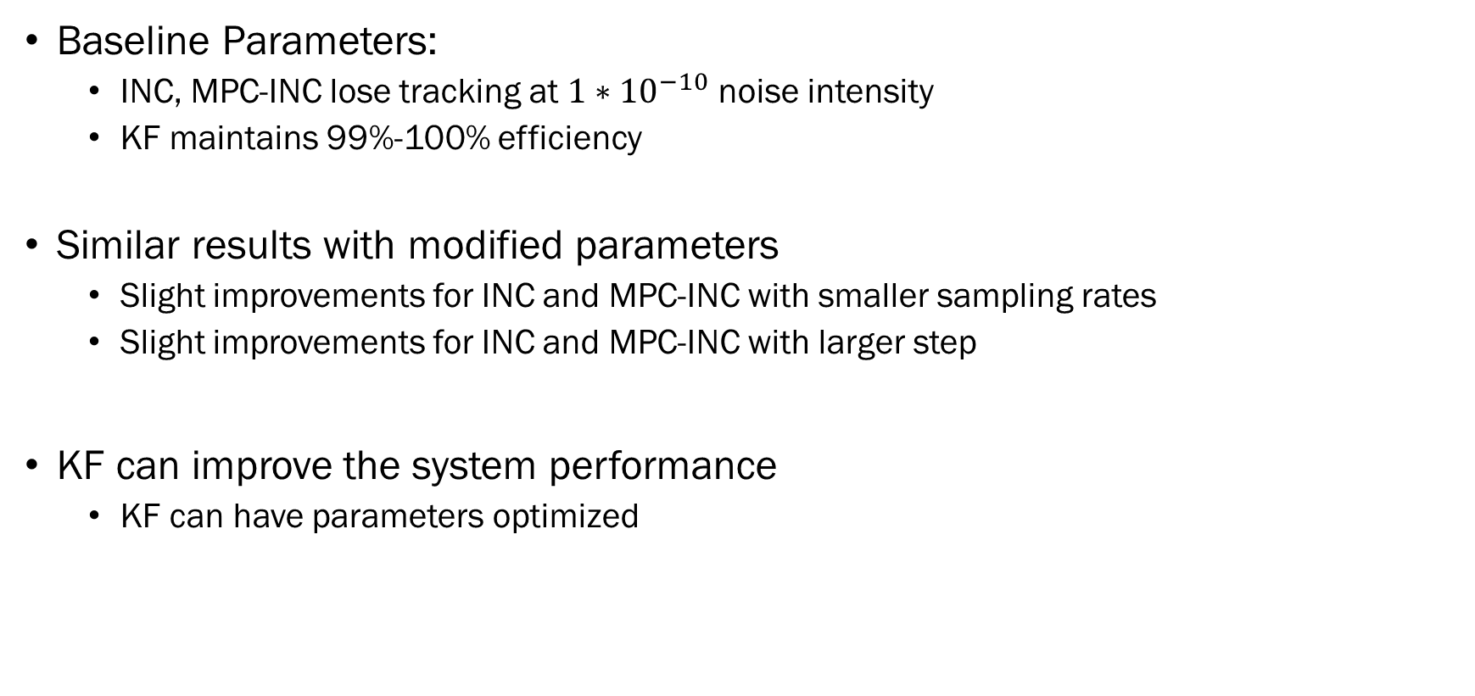
Discussion – with Noise
Baseline Parameters:
INC, MPC-INC lose tracking at $1∗{10}^{−10}$ noise intensity
KF maintains 99%-100% efficiency
Similar results with modified parameters
Slight improvements for INC and MPC-INC with smaller sampling rates
Slight improvements for INC and MPC-INC with larger step
KF can improve the system performance
KF can have parameters optimized
49

Slide 50
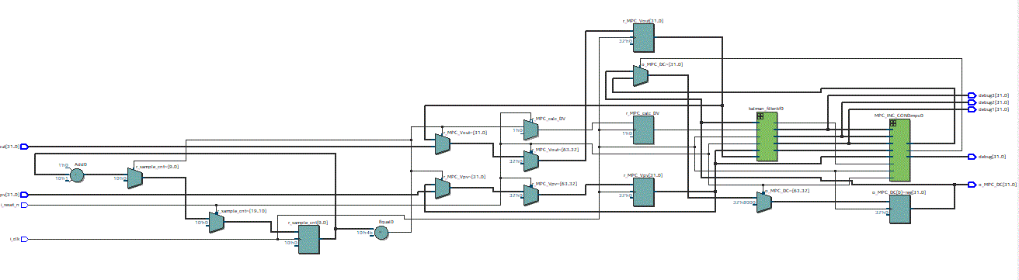
FPGA HIL
Intel Cyclone V utilized 4000 ALM blocks, 51 DPS blocks; met timing requirements
RTL design of KF-MPC-INC Algorithm for Cyclone V FPGA, Top-Level
Resource Utilization of KF-MPC-INC Algorithm for Cyclone V FPGA
Module | Logic Utilization | Logic Utilization W/o Division IP Core | Max Clock Freq. | Max Clock Freq. W/o Division IP Core | Clock Cycles Needed for Computing One Sample (latency)
Kalman Filter | 4025 ALMs | 2616 ALMs | 7.79 MHz | 47.54 MHz | 42
MPC-INC | 1685 ALMs | 295 ALMs | 8.30 MHz | 107.34 MHz | 11
Full System | 5685 ALMs | 2866 ALMs | 7.79 MHz | 47.54 MHz | 53
50

Slide 51
FPGA HIL Power Analysis
FPGA simulation of KF-MCP-INC versus MATLAB equivalent, No Noise
FPGA simulation of KF-MPC-INC versus MATLAB equivalent, Noise $at 1∗{10}^{−10}$
51

Slide 52
Outline of Presentation
Introduction
Background and Literature Review
Significance
Experimental Design
Results and Discussion
Conclusion
52

Slide 53
Conclusion
Algorithm design is high performance, comparable to other high performance systems
Performance levels remained the same in noisy environments, and is capable of outperforming similar algorithms when noise is present.
FPGA design provided insights into design aspects, hardware requirements, practicality of implementation, and real-world testing results
Reduced sensor count improved system efficiency/cost and improve practicality of implementation
53

Slide 54
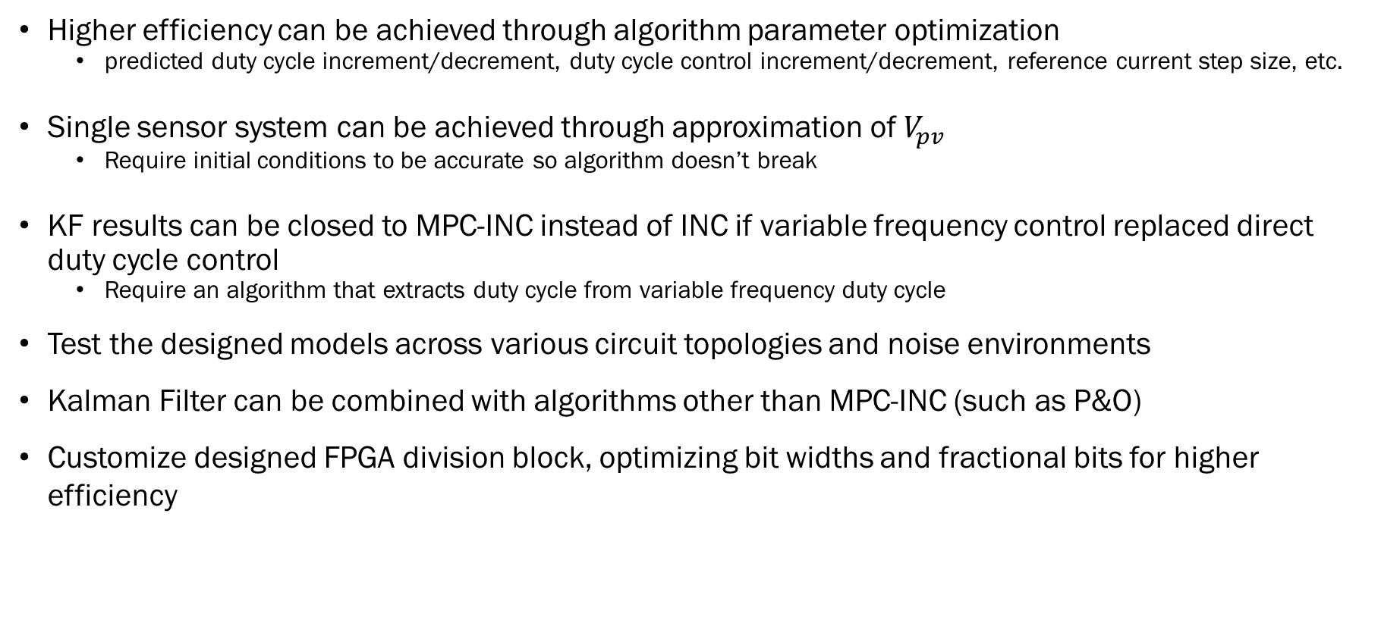
Future Work
Higher efficiency can be achieved through algorithm parameter optimization
predicted duty cycle increment/decrement, duty cycle control increment/decrement, reference current step size, etc.
Single sensor system can be achieved through approximation of $V_{pv}$
Require initial conditions to be accurate so algorithm doesn’t break
KF results can be closed to MPC-INC instead of INC if variable frequency control replaced direct duty cycle control
Require an algorithm that extracts duty cycle from variable frequency duty cycle
Test the designed models across various circuit topologies and noise environments
Kalman Filter can be combined with algorithms other than MPC-INC (such as P&O)
Customize designed FPGA division block, optimizing bit widths and fractional bits for higher efficiency
54

Slide 55

56

